Slide 1
Touchshow Introduction
Notes:
Mode=canvas_neglect_back; pptcolor=0x558ed5;

Slide 2
What is Touchshow
Slide show tool, based on PPT format but show your slides on all platforms,
with many amazing features

Slide 3
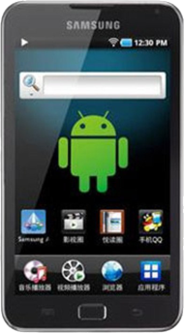
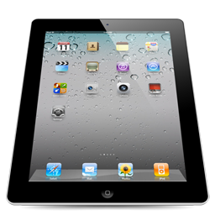
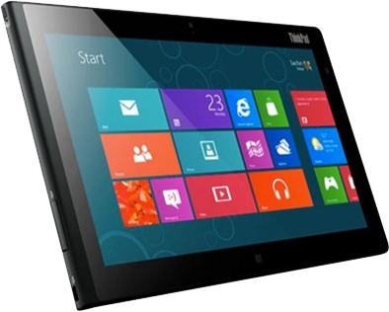
Support platforms includes iOs/Android/Windows on PC
Able to convert ppt to html5 so as to be viewed on modern browsers, including mobiles

Slide 4
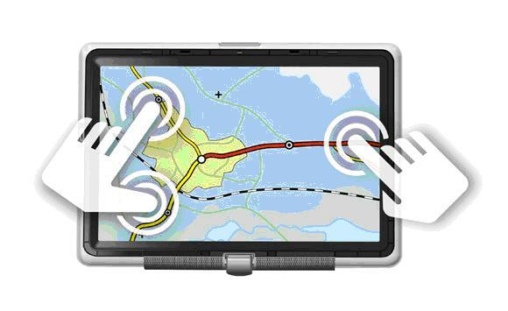
Multi-touch enabled during presentation
Move
Rotate
Pinch
Difference Slide Show Experience

Slide 5
Mind Map playing mode
Present idea in layers
Show relationship between concepts
Catch eyes with amazing effects
Impress your audiences

Slide 6
Local player vs. Online service
Play with mobile device
Access everywhere on web
Fashion
Facility

Slide 7
Interactive Playing vs. Auto Slide Show
Touchshow HTML5 converter converts your ppt to web pages so that it could be accessed everywhere.
Touchshow PPT Player on Android could play your slide show with animation, audio, video, hyperlink …
Touchshow HTML5 Converter help to publish your slide show online and in order to share with your friends
Click to know Touchshow on Android
Touchshow on Android
Click to know Touchshow HTML5 converter
Touchshow HTML5 converter
Great tool for fresher to design interactive page

Slide 9
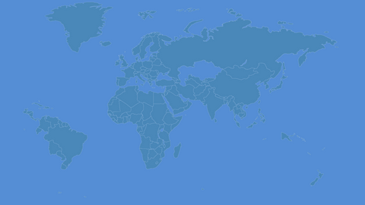
Try today!
Sign up

